Slide 1
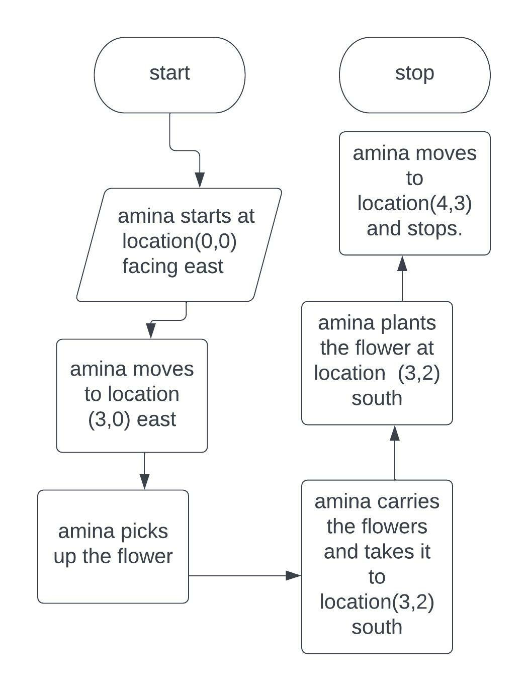
PSEUDO CODE AND ALGORITHM FOR PROJECT 1
SET aminat at (0,0)
MOVE aminat to (3,0) east
LET aminat pick up flower
MOVE aminat to (3,2) south
LET aminat plant flower (3,2)south
MOVE aminat to (4,3)and STOP

Slide 2
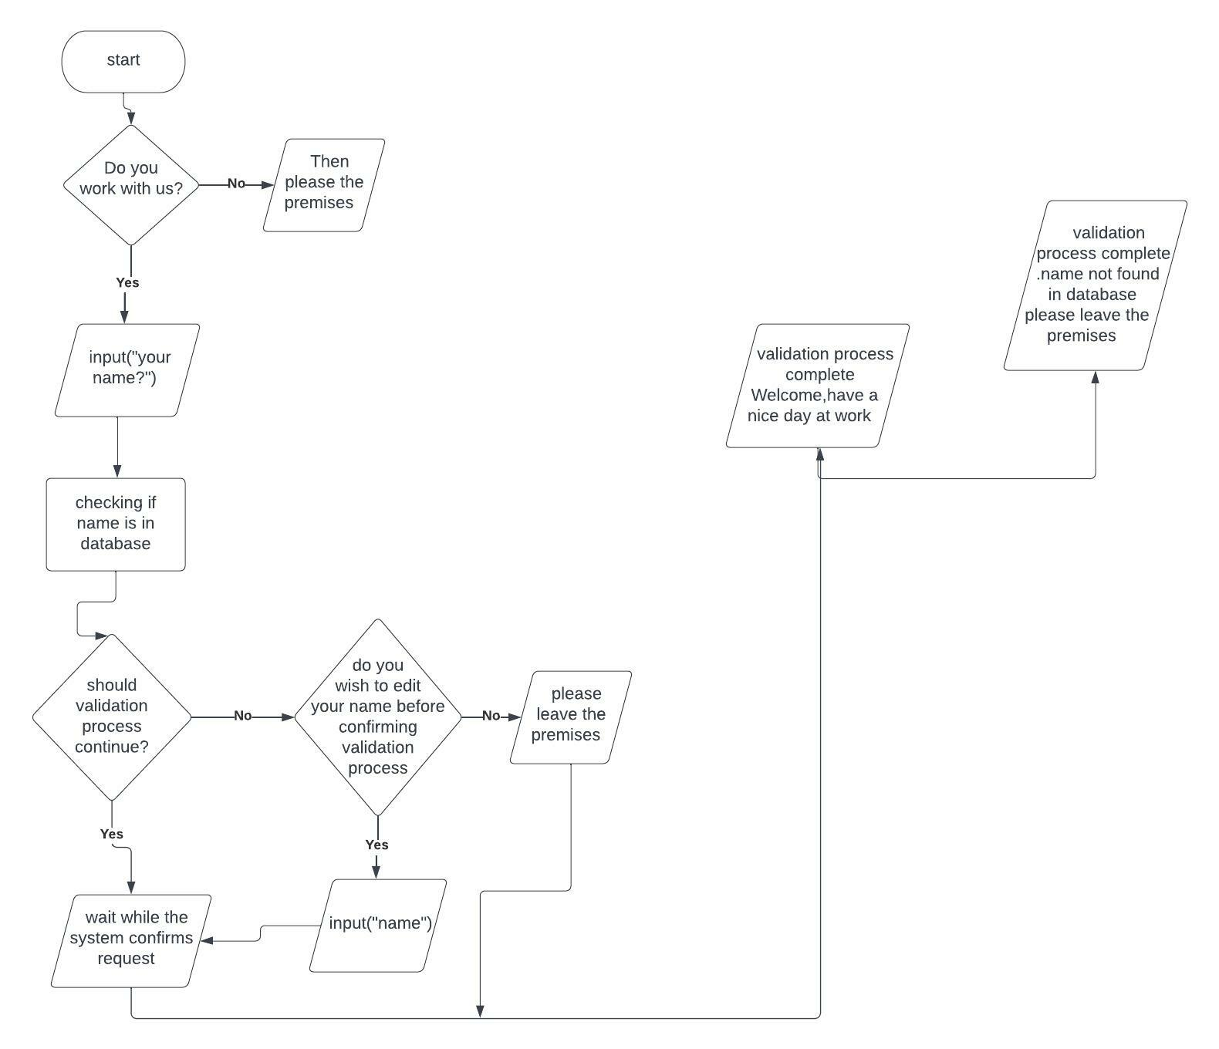
PSEUDO CODE AND ALGORITHM FOR PROJECT 2
START
INPUT please your name?
PRINT wait while we check for your name in our database
IF name is in database
PRINT welcome,have a nice day at work
ELSE
PRINT sorry but your name isnt found in our database.kindly leave our premises.
STOP

